Slide 1
Probability Distribution
A probability distribution is a mathematical function or rule that describes how the probabilities of different outcomes are assigned to the possible values of a random variable.
It provides a way of modeling the likelihood of each outcome in a random experiment.
Described by PMF and PDF.
Types: Discrete Probability Distributions
Continuous Probability Distributions

Slide 2
Discrete Probability Distributions
Bernoulli distribution
Binomial Distribution
Poisson distribution

Slide 3
Bernoulli Trial
An experiment or process that has exactly two possible outcomes, usually labelled
  Success (1 ) — happens with probability p
  Failure (0) - happens with probability 1- p
Key Features of a Bernoulli Trial:
  Two outcomes only : success/failure, yes/no, head/tail, defective/good, etc.
  Fixed probability of success (p): does not change from trial to trial.
  Independence: Outcome of one trial does not affect the outcome of another.

Slide 4
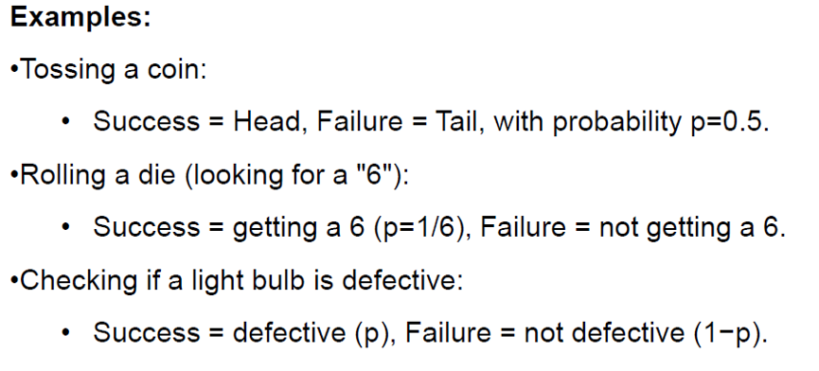
Bernoulli Trial

Slide 5
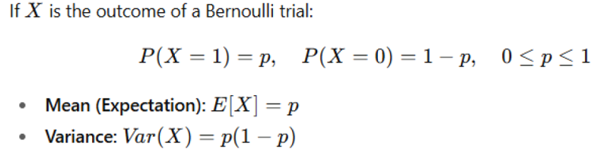
Bernoulli distribution

Slide 6
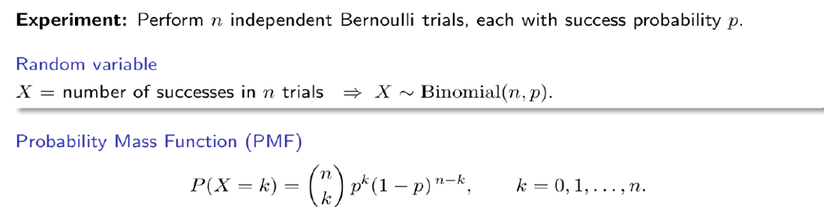
Binomial Distribution

Slide 7
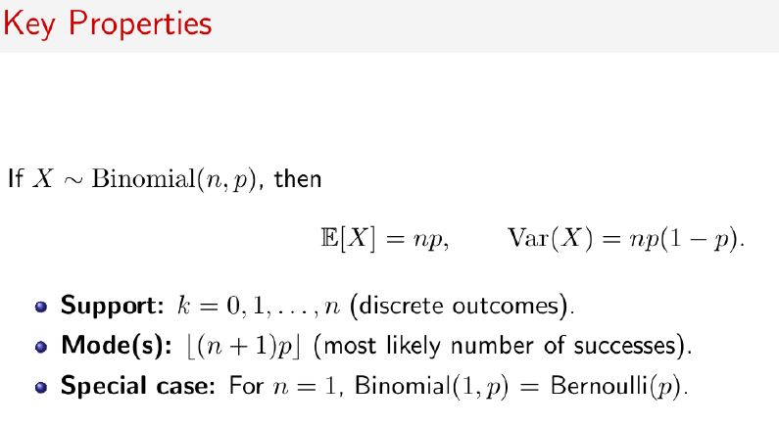
Binomial Distribution

Slide 8
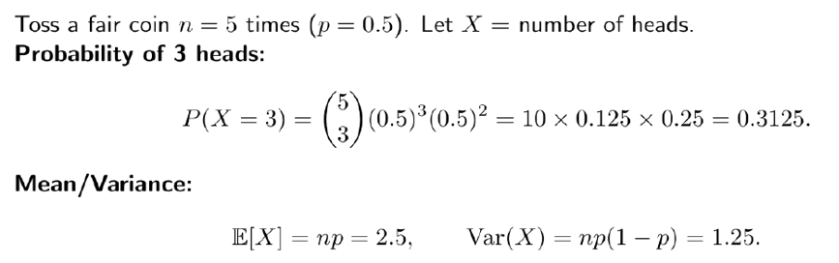
Example

Slide 9

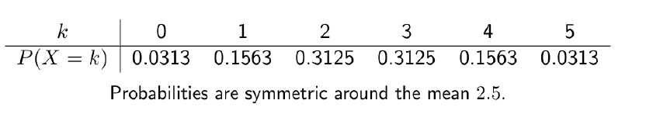
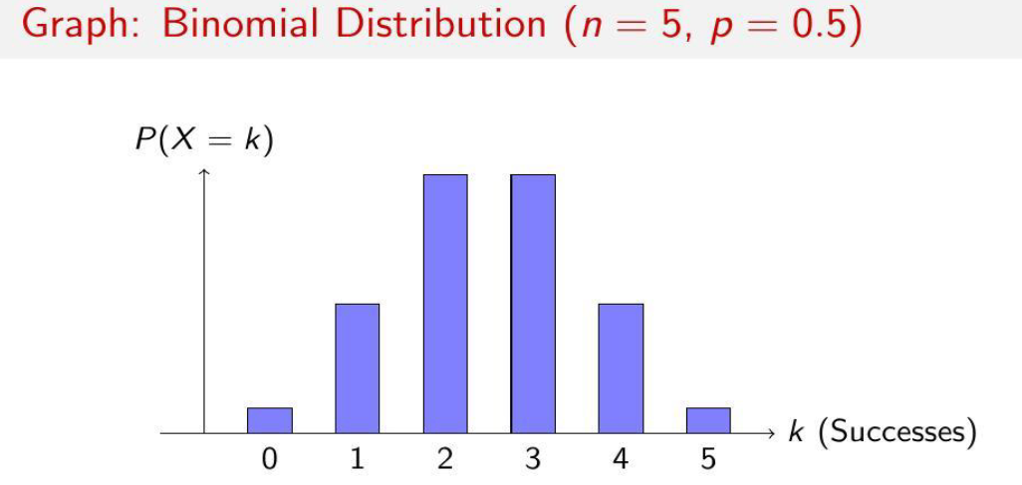
Example

Slide 10
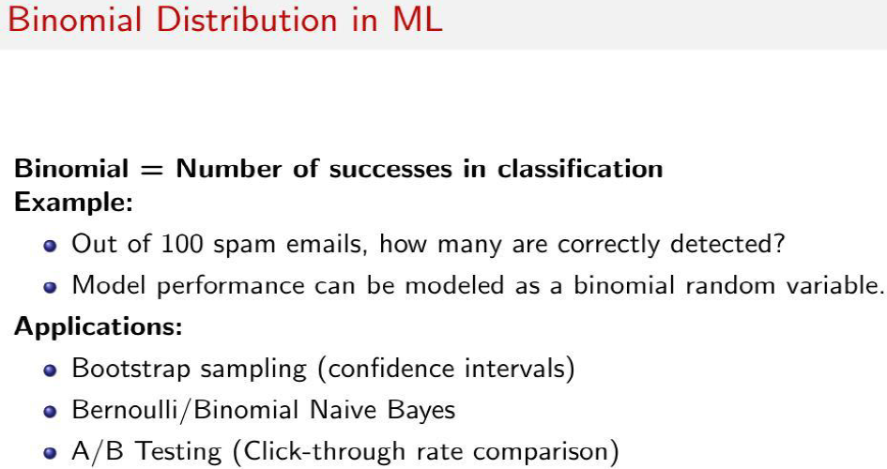

Slide 11
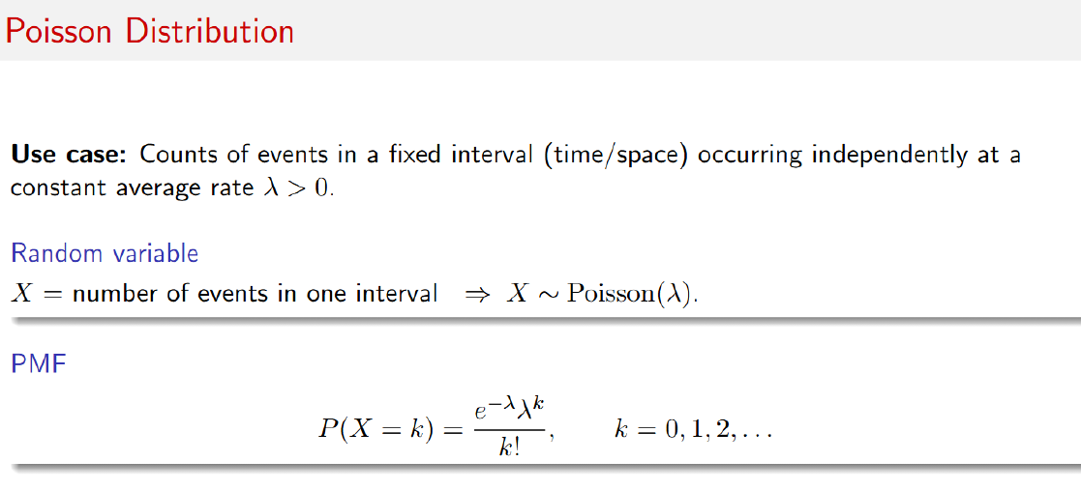

Slide 12
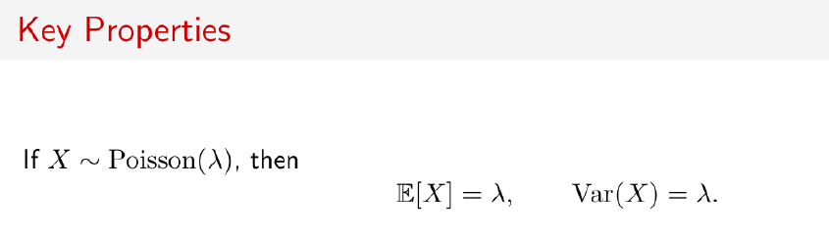
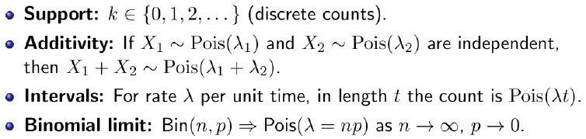
POISSON DISTRIBUTION

Slide 13
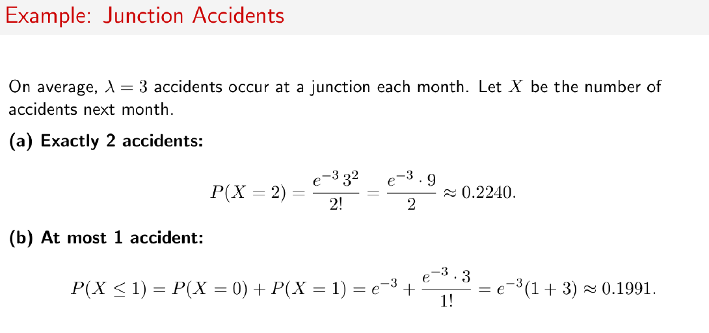

Slide 14
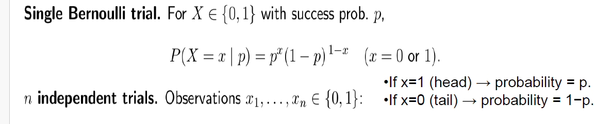
BERNOULLI DISTRIBUTION

Slide 15
Continuous Probability Distributions
Uniform distribution
Normal distribution
Exponential distribution

Slide 16
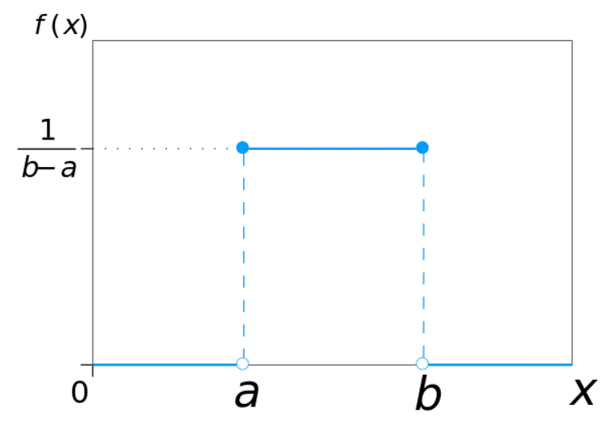

Uniform distribution
Uniform Distribution models equally likely outcomes over a closed interval [a,b], where the probability is uniform.

Slide 17
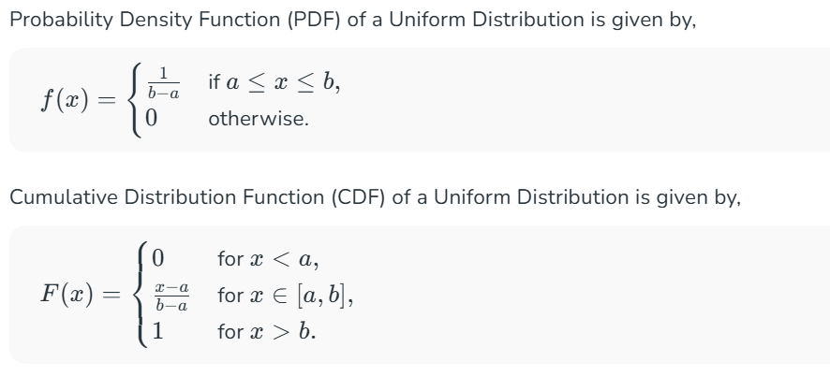
Uniform distribution

Slide 18
Uniform distribution: Example
Consider the time it takes for a traffic signal to turn green after it has been red. Assume that the time the signal takes to turn green is uniformly distributed between 20 seconds and 40 seconds.
The minimum value (a) = 20 seconds. The maximum value (b) = 40 seconds.
The continuous uniform distribution function:
f(x) = 1 / (40–20) = 1 / 20 for 20 ≤ x ≤ 40
f(x) = 0 otherwise
At any time between 20 seconds and 40 seconds, the probability of the signal turning green has an equal probability of 1/20.
The probability of the signal turning green in exactly 25 seconds = 1/20.
Similarly, the probability of the signal turning green in exactly 30 seconds = 1/20.

Slide 19
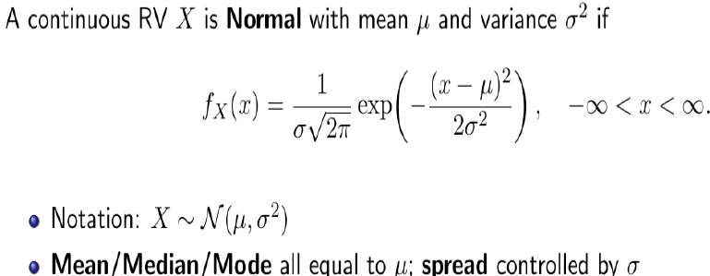
Normal distribution or Gaussian distribution
The parameter ⁠μ is the mean or expectation of the distribution, while the parameter σ² is the variance. The standard deviation of the distribution is ⁠σ(sigma).

Slide 20
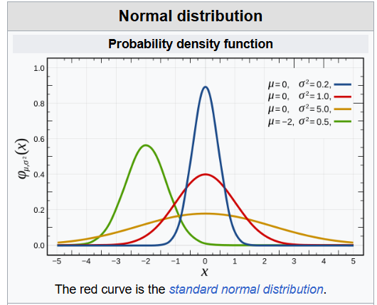
Normal distribution or Gaussian distribution
A random variable with a Gaussian distribution is said to be normally distributed, and is called a normal deviate.

Slide 21
Normal Distribution Examples
We can draw a Normal Distribution for various types of data that include,
Distribution of Height of People.
Distribution of Errors in any Measurement.
Distribution of Blood Pressure of any Patient, etc.

Slide 22
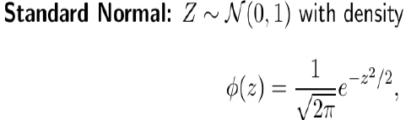
Standard normal distribution
Normal distributions with a mean ⁠μ and standard deviation can be transformed into the standard normal distribution with mean of zero and standard deviation of one.

Slide 23
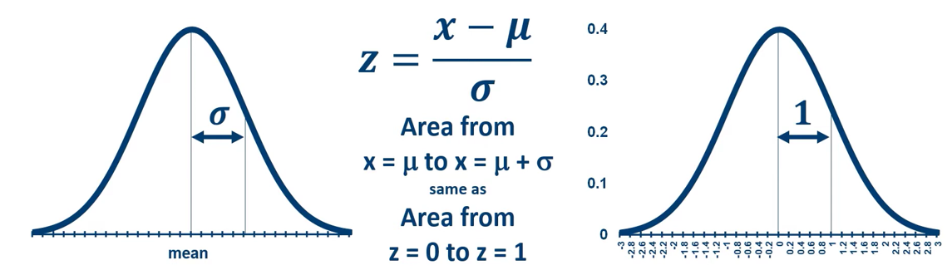
Standard normal distribution
Regions within the original normal distribution correspond to regions in the standard normal distribution.
Areas in the standard normal distribution are known and tabulated in tables (or stored in statistics programs).

Slide 24
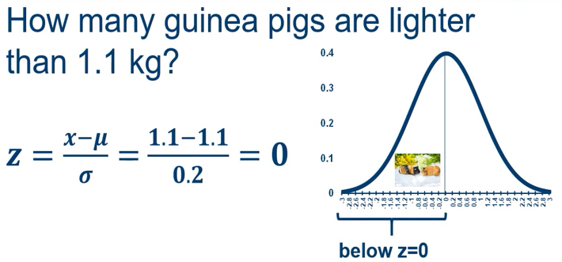
Example 1
Consider a population of 80 guinea pigs in which the mean mass is 1.1 kg and the standard deviation is 200g (0.2 kg).

Slide 25
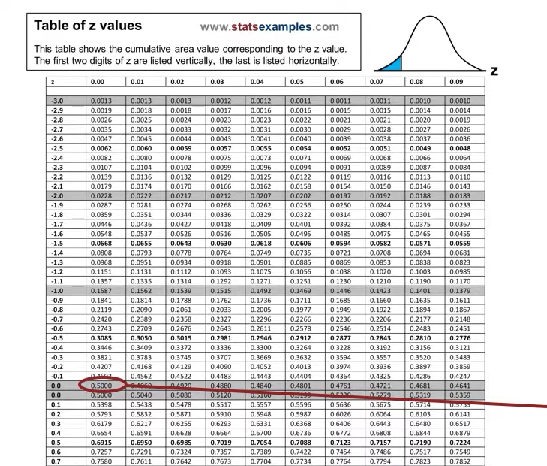

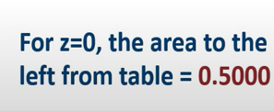
Example 1-answ

Slide 26
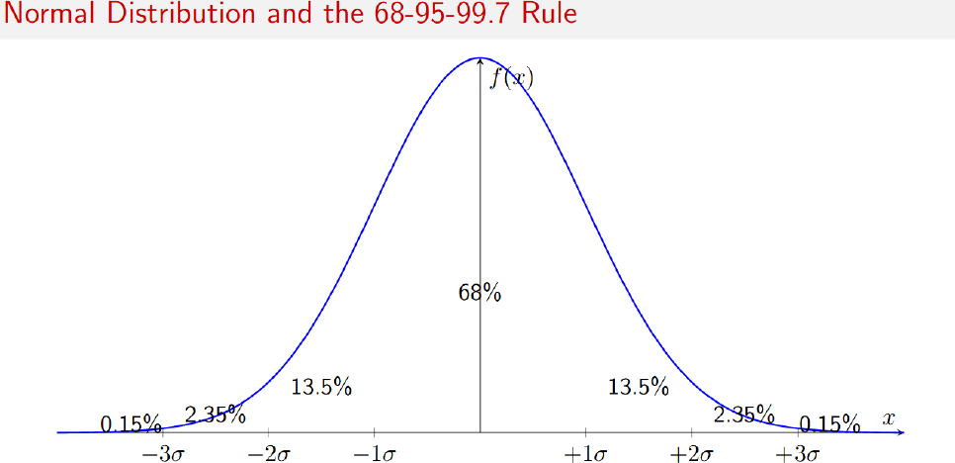

Slide 27
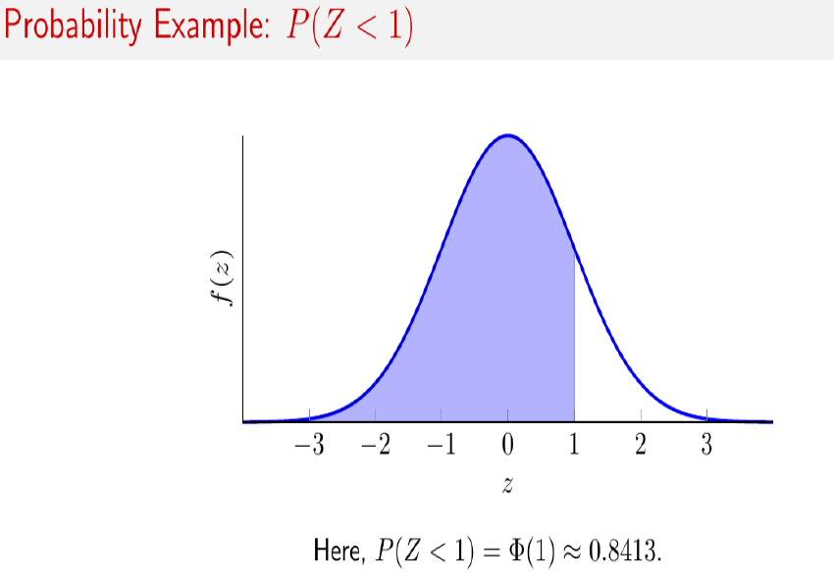

Slide 28
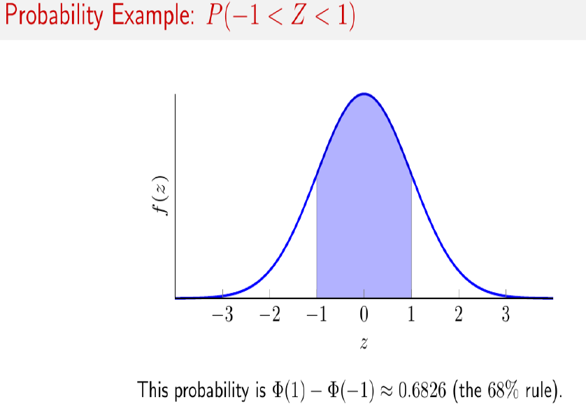

Slide 29
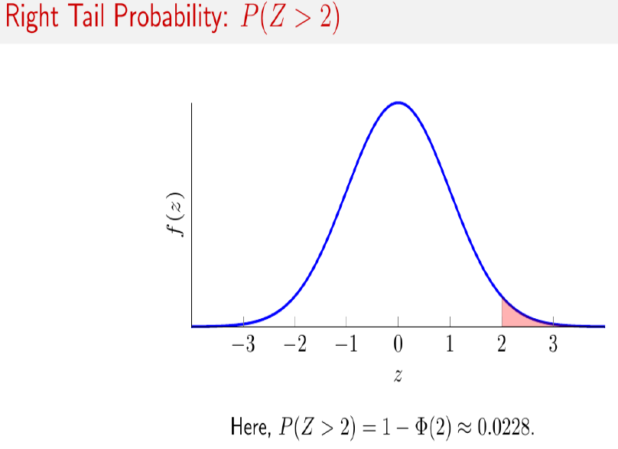

Slide 30
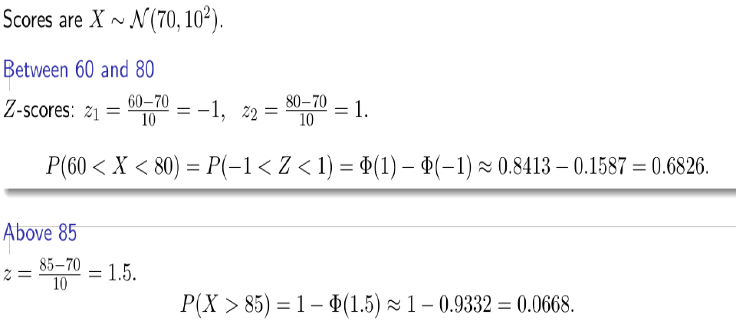

Slide 31
Exponential distribution
The Exponential Distribution is one of the most commonly used probability distributions in statistics and data science.
It is widely used to model the time or space between events in a Poisson process.
In simple terms, it describes how long you have to wait before something happens, like a bus arriving or a customer calling a help center.
For example, if buses arrive at a bus stop every 15 minutes on average, the time you wait for the next bus can be modelled using an exponential distribution.

Slide 32
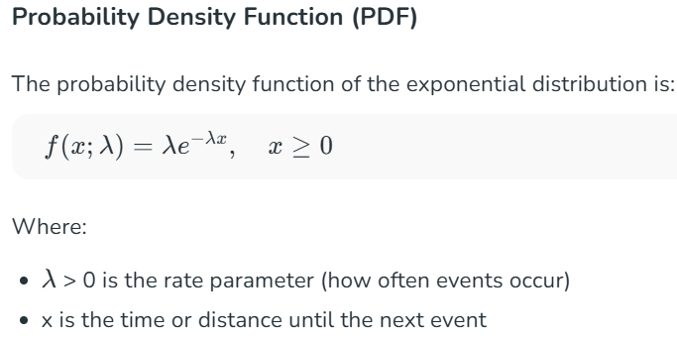
Exponential distribution

Slide 33
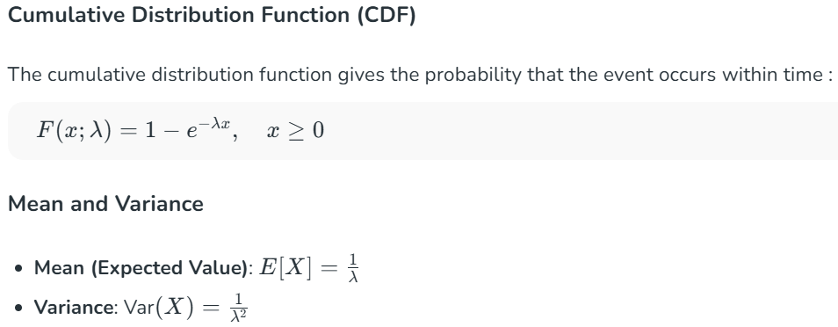
Exponential distribution

